Slide 1
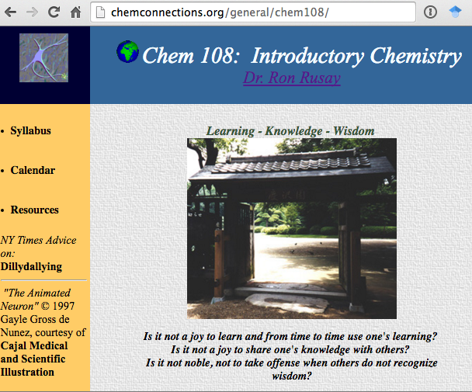
Greetings & Welcome to Chem 108
Introductory Chemistry
http://chemconnections.org/general/chem108/
If you are enrolled or on the wait list, please pick up a course Syllabus @ the front of the class.
Please hold ALL of your questions.
They will be answered shortly in the slides that follow.
Dr. Ron Rusay
Class: MW 11:10-12:35 (PS 277)
Discussion/Lab:
12:45-3:55 M (PS 217) sec. 2341
12:45-3:55 W (PS 217) sec. 2343

Slide 2

Greetings & Welcome to Chem 108
Introductory Chemistry
http://chemconnections.org/general/chem108/

Slide 3

Message from President
Susan E. Lamb
“I am very glad that you are here and I want you to feel welcome, safe and connected to our college. DVC values each and every one of you, and does not tolerate racist attitudes or hate speech of any kind. If you see or hear anyone spreading hate language anywhere on our campus, please tell me or contact Newin Orante (Vice President of Student Services) or Police Services. We take such incidences very seriously and will pursue and prosecute hate crimes on our campuses.”

Slide 4
Chem 108
http://chemconnections.org/general/chem108/108syl19f.html
Please be sure to sign the roster next to your name on the clipboard that is circulating.
The rosters and wait lists are full. The sections are closed. If you are not listed, there is no way to add.
Class size is limited to 28 max due to lab safety. Anyone on the roster who is absent today will be placed last on the roster after the wait listed sign-ins.
28 lab drawers will be assigned in lab to the first 28 on the completed list. Add codes will be provided at the end of the first lab meeting: Today & Wednesday.

Slide 5
CONNECTIONS
Show of hands for each choice (A-D)
I personally have or have easy (24/7) access to:
a smart phone
a personal computer
the Internet
a printer
If you DO NOT have a smartphone or DO NOT have easy access to B.), C.), or D.), please make an appointment to meet with Dr. R. as soon as possible to get more information and work out a plan to conveniently use them. It is essential that you can use certain technology; all but smartphones are available for use on the DVC campus.
Notes:
Rooted in observations (reality? & truthful?); empiricism

Slide 6
Take out your smart phone.
If you don’t have it with you, introduce yourself to a class mate and share theirs.
Open DVC wifi.
Connect to the Internet.
Go to:
http://chemconnections.org/general/chem108/
Click on Syllabus
link

Slide 7
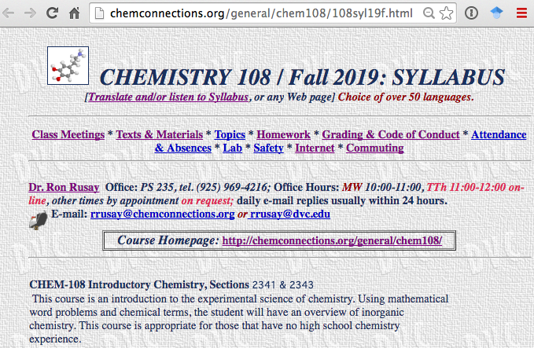
Chem 108
http://chemconnections.org/general/chem108/108syl19f.html
Syllabus
link

Slide 8

CONNECTIONS
Chemistry, STEM & Applications
Why am I enrolling in CHEM 108?
It is a required course that is needed to meet my higher education goals. I have to take it.
Chemistry is very easy to me and I need the 4 credit A to boost my GPA.
I am very interested in science and chemistry.
I’m not sure.
Show of hands; i-clickers or Reef App to be used in future class meetings.)
https://app.reef-education.com/#/account/create
Notes:
Rooted in observations (reality? & truthful?); empiricism

Slide 9

CONNECTIONS
Chemistry, STEM & Applications
My plan after completing Chem 108 is to:
take General Chemistry : (If @ DVC: Chem 120)
take Integrated Inorganic, Organic, and Biological Chemistry: (If @ DVC: Chem 107)
take Introduction to Organic and Biochemistry: (If @ DVC: Chem 109).
NOT take other chemistry courses after Chem 108.
Show of hands; i-clickers or Reef App to be used in future class meetings.)
https://app.reef-education.com/#/account/create
Notes:
Rooted in observations (reality? & truthful?); empiricism

Slide 10
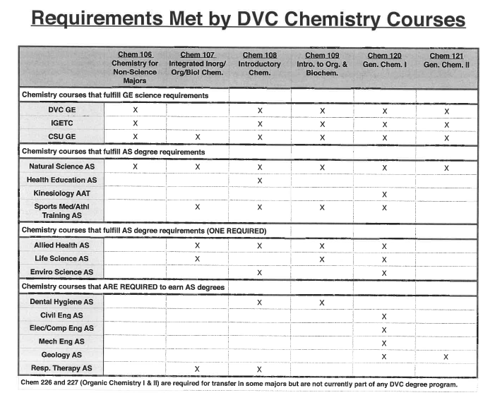
CONNECTIONS
Notes:
Rooted in observations (reality? & truthful?); empiricism

Slide 11
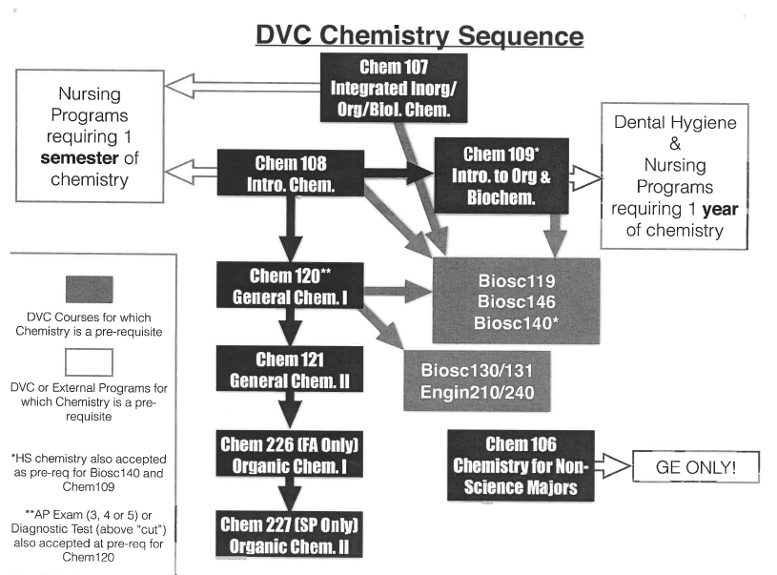
CONNECTIONS
Notes:
Rooted in observations (reality? & truthful?); empiricism

Slide 12
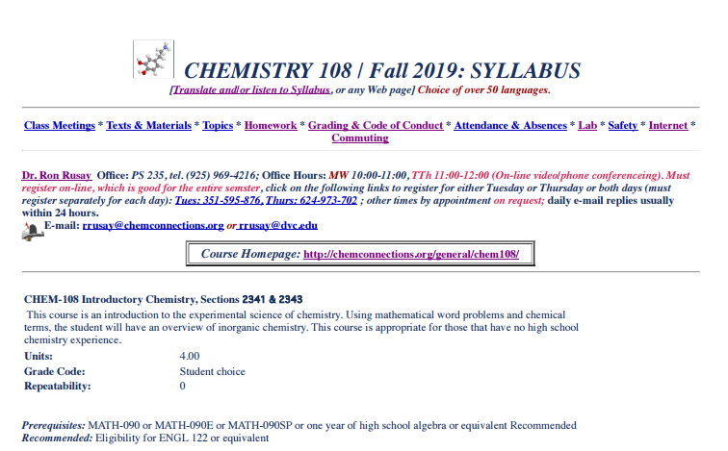
Chem 108: Class/ Lab
http://chemconnections.org/general/chem108/108syl19f.html
$$$???
First Timers:
Tuition Free
(Get information from DVC A &R)
$$$???
Course Materials:
Kept as low as possible
Please read carefully, after today’s class.

Slide 13
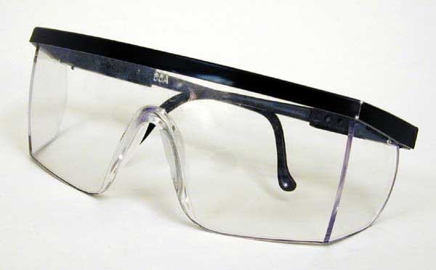
Chem 108
http://chemconnections.org/general/chem108/108syl19f.html
Resources: (REQUIRED/MUST HAVE)
Chem 108 Lab Manual (Available in the DVC Bookstore: $17.95)
Webassign: Class Key, dvc 3947 0654, provides access to all of the Webassign resources through your account, which includes An Introduction to Chemistry e-book with associated questions and supporting resources ($41.00) (Hard copies of An Introduction to Chemistry, Atoms First ISBN978-0-9778105 can be purchased @ $74.45.)
i<clicker: The older version is acceptable, as well as the newer .2 and i-clicker+ versions ($5.00-$40.00 on-line & DVC); i-clicker Reef Access ($14.99)
Personal e-mail account. (DVC/CCCCD “Insite” account not recommended, but ok.)
Notebook: 3 ring recommended
Access to the Internet (Can be limited, such as only on the DVC Campus or at free WiFi hotspots)
Lab safety glasses with side shields or goggles on sale by DVC Chem Club

Slide 14
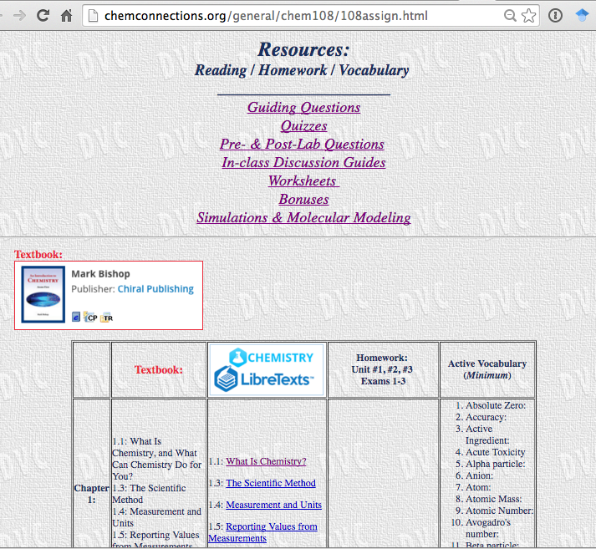
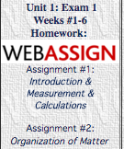
Chem 108
http://chemconnections.org/general/chem108/108assign.html
From Homepage
Click on Resources
link
  Resources:
  Reading / Homework/
  Vocabulary/
  Guiding Questions / Quizzes/ Discussion Guides/
  Worksheets/ Simulations & Molecular Modeling

Slide 15

Libretext aka ChemWiki alternative to or additional resource for textbook
https://chem.libretexts.org
Must enroll in Webassign regardless of choice.

Slide 16
Chem 108
http://chemconnections.org/general/chem108/108syl19f.html
Grading:
i-clicker questions/in-class participation + answers to on-line Guiding Questions + on-line simulations/quizzes are valued at 15% of the TOTAL grade.
Webassign completed work is valued at 15% of the TOTAL grade.
Laboratory experiments, activities, pre- & post-lab questions, worksheets and simulations are valued at 25% of the TOTAL grade.
3 exams, each comprising 15% of the TOTAL grade, and, in total, equal to 45% of the TOTAL grade.

Slide 17
Chem 108
http://chemconnections.org/general/chem108/108syl19f.html
Exam Dates: 9/30, 11/4, 12/18
. [Cell phones will not be allowed during exams and quizzes.]
Final letter grades will be assigned based on an overall average in the following ranges: 87-100 A; 75-86 B; 60-74 C; 50-59 D; <50 F, using normalized class averages.
NOTE: The DVC Code of Conduct will be strictly enforced. Cheating and plagiarism are unacceptable and will unconditionally result in a failing grade
SEE: DVC Academic College Policies

Slide 18
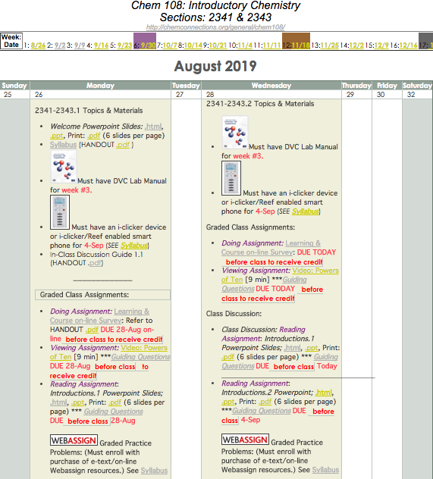
Chem 108: Beginning of a Journey
http://chemconnections.org/general/chem108/calendar-108-f19.html
From Homepage
Click on Calendar
link
Follow the Viewing-Reading-Doing links in the calendar
to lead you on your path.

Slide 19
Chem 108
Refer to the course calendar page TODAY & frequently. The current week’s calendar is set the beginning of the week, and is then static. Plan by each week……. Execute day-by-day. Meet all due dates!!
Before coming to each class/lab meeting: Read, View & Do the scheduled activity links: Videos, Powerpoint Class Slides, Notes, Worksheets, Simulations, etc.
Answer all on-line Guiding Questions.
Review and consider logical answers & explanations for the embedded Powerpoint i-clicker questions, then refer to the correct answers, which are presented in class. Bring any questions for discussion to the class meetings and Office Hours.
Complete WEBASSIGN Homework, all lab assignments, activities & worksheets.
Individually and collaboratively use all available resources to develop a sufficient level of mastery of the class/lab vocabulary, problems, and topics to understand the chemistry / science and be able to explain concepts clearly to someone else.

Slide 20
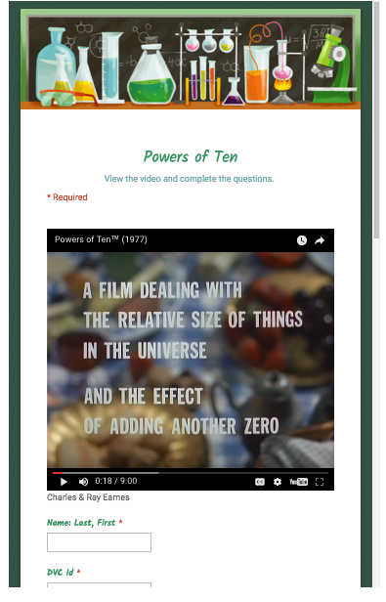
Hearing/Viewing: Guiding Questions (GQ)
Measurements & Relative Scale
http://chemconnections.org/general/chem108/Powers%20of%20Ten-Guide.html
Answer all on-line Guiding Questions.
First GQ assignment
Due before next class.
https://www.youtube.com/watch?v=0fKBhvDjuy0
From the calendar links, submit responses on-line; graded weekly.

Slide 21

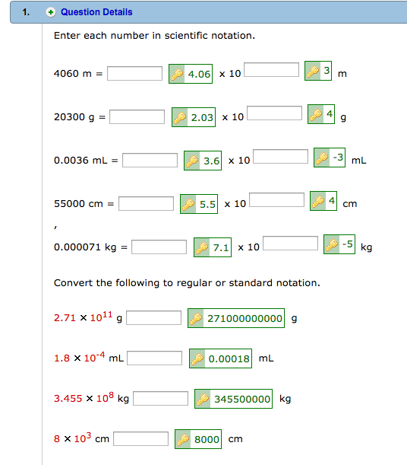
Homework
https://www.webassign.net/v4cgi/selfenroll/classkey.html
Class Key: dvc 3947 0654
http://chemconnections.org/general/chem108/Student_Quick_Start_Guide_SE.pdf

Slide 22

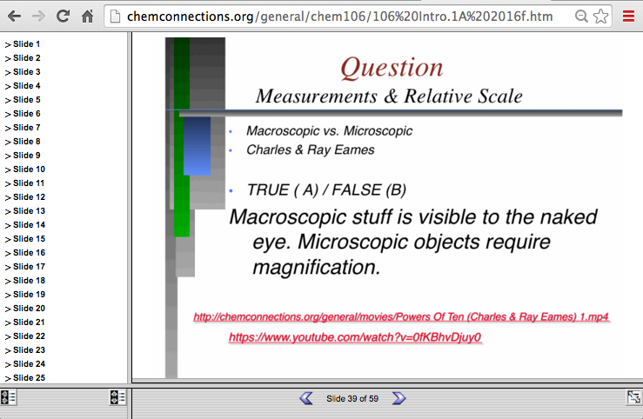
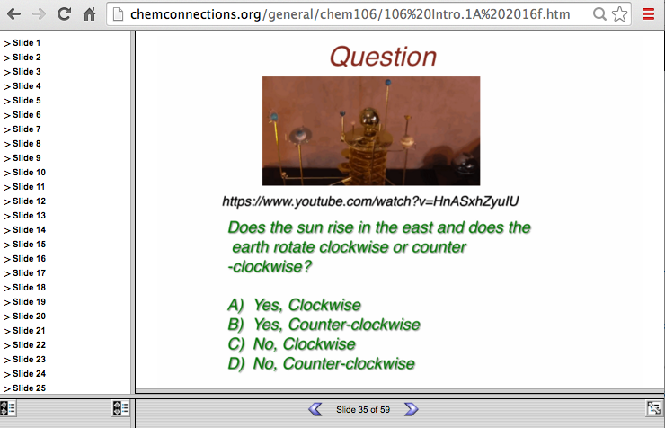
Reading: Powerpoint Slides
Embedded i-clicker Questions
Read Powerpoint slides before class (can be printed), consider embedded questions; answers will be provided in class. One of these questions will be asked @ the start of the following class. Only answers submitted with a personal, registered i-clicker or smart phone will receive credit.
These slides & questions will be the basis for a significant part of exams.

Slide 23

Refer to Calendar’s Next & Future
Classes/Labs
http://chemconnections.org/general/chem108/calendar-108-f19.html
The calendar is dynamic and has the class plan for the period through Exam-1. Beyond the current week it is tentative, but very useful for planning.

Slide 24
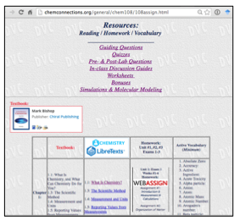
Also Refer to Resources Page
http://chemconnections.org/general/chem108/108assign.html
The Resources page includes links related to assignments and textbook and LibreTexts reading.

Slide 25

How much time beyond class & lab time will all of this take?
http://chemconnections.org/general/chem108/calendar-108-f19.html
All of the outside assignments &
homework are designed for ~1.5-2 hrs/day, but the answer will depend on you!
Budget your time & get help when needed!! DON’T WAIT!!

Slide 26
Where to get tutoring help, if & when needed?
Dr. R. MW 10:00-11:00 PS 235;
On-line video/phone conferencing TTh 11:00-12:00;
Other times by appointment (through e-mail request);
Daily e-mail (replies usually within 24 hours) ;
DVC: peer tutoring beginning Sept. 3rd
PS110: M, T, W, & Th (9 am – 7pm) and Fridays (9 am to 1 pm)
(On-line) NetTutor: total of five hours free tutoring for the fall semester through Canvas; must be requested by e-mail through Dr. R.
Get help when needed!!
DON’T WAIT!!

